Slide 1
Yip Hei Tung Hazel
Danny’s Dream

Slide 2
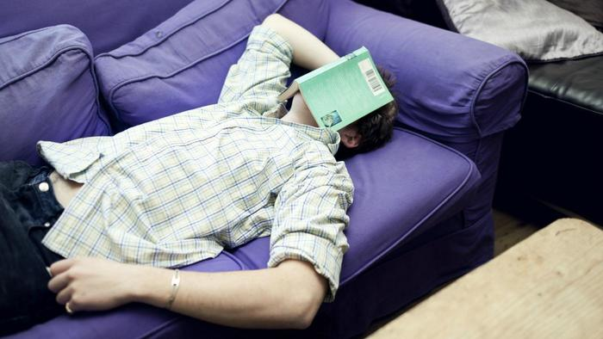
One day Danny found a photo album. The photo album was about Great Grandma. Danny fell asleep when he was looking at it.

Slide 3
In his dream, he saw Great Grandma. A man in the black suit caught her because Great Grandma did some bad things. Danny saw it and fought with the loathsome bad man. The loathsome bad man was a killer. He caught Great Grandma to a crammed dusty room. Danny helped Great Grandma so the killer was angry.

Slide 4
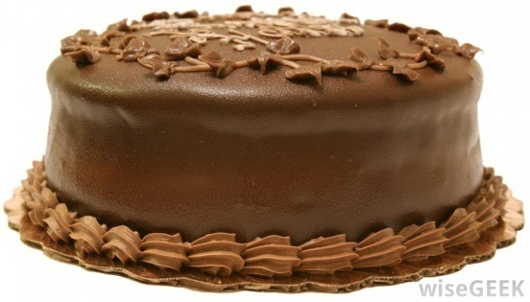

He fought with Danny. Great Grandma worried about herself. Danny felt scared because the loathsome bad man wanted to kill Great Grandma . The loathsome bad man gave Great Grandma a cake but there was a gun inside. When Great Grandma ate it, the loathsome bad man killed Great Grandma with the gun. Great Grandma died in the end.

