Slide 1
A diary
My first day as a prefect
Tang Tsz Ching Dorothy

Slide 2

1stSeptember, 2016 Sunny
Today was my first day to be a prefect.
I saw some naughty pupils at school. I
was so excited to be a prefect. I want to
be a responsible prefect.

Slide 3
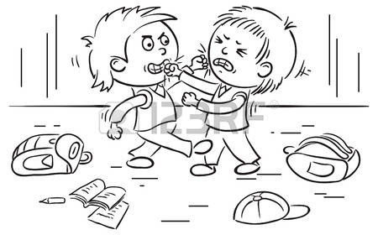
I was on duty at the first recess near
the stairs. I saw one schoolmate jump
on the floor. Then I said, ‘Keep left and
walk slowly on the stairs.’ But he didn’t
listen to me so I took out my record
book to write his name.

Slide 4
Then I was on duty at the second
recess in the playground. I saw two
schoolmates fight with each other.
I stopped them from fighting. Then I
wrote down their names on the record
book. They felt regretful. I felt glad.
At last, I hope all the schoolmates can behave well.

