Slide 1
One day trip
Lam Ngai Man Charmaine

Slide 2

Want to have a trip? Join “Happy One Day Trip!”
In the morning, we will take
you to Ocean Park. You can
see the cute dolphin show,
enjoy the exciting rides or
ride on the cable car!

Slide 3
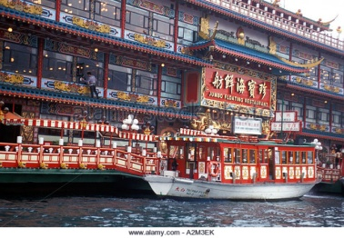
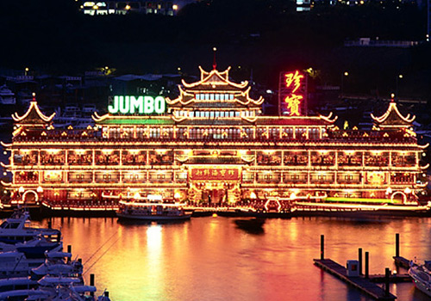
In the afternoon, maybe you are hungry. We will take you to Aberdeen and have a scrumptious lunch! We will go to Jumbo restaurant and have fresh seafood! Isn’t it delicious? The restaurant building is also amazing! You will like it very much!

Slide 4
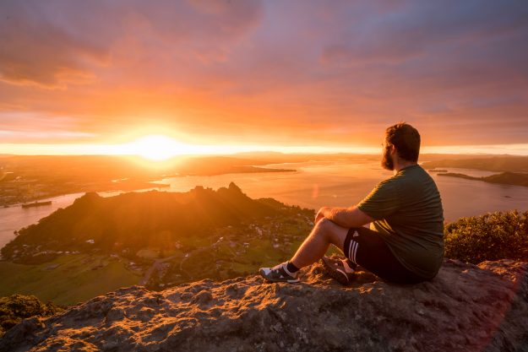
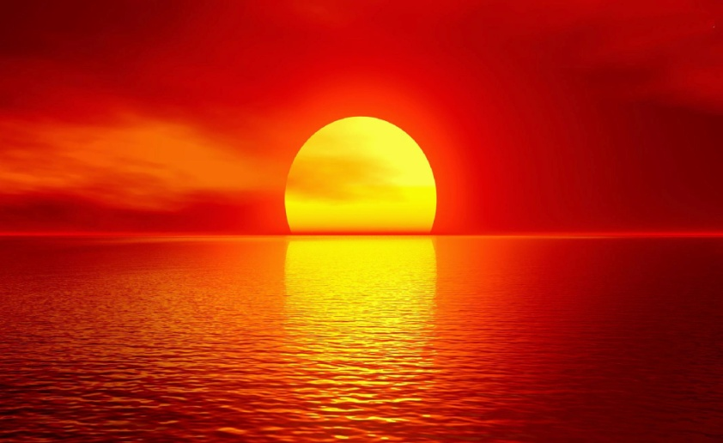
In the evening, we will take
you to watch the stunning
sunset. It is so beautiful! We
know you will be surprised!
You can take photos with
the sunset. We know you
think it is great, right?
Join Happy One Day Trip!

