Slide 1
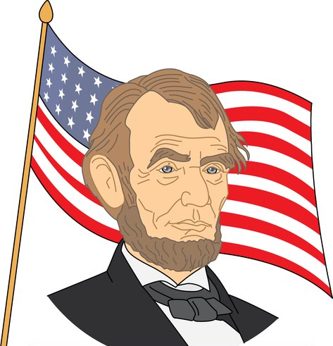
A biography
Cheung Tat Long Edward

Slide 2
I am exceedingly famous in 2057. All the people know me including kids. I am an extraordinarily outstanding president in the US now.
I am Edward Cheung. In 2057, I am 51 years old. I am not too senile. I became the president’s right-hand man in 2022. Moreover, I promoted in 2025. I have been a finance

Slide 3
minister until 2050. I devoted myself to the job. I worked for 14 hours a day. I was generally exhausted in those days.
Eventually, I participated in the presidential election in 2050. Greatly fortunately, I won the presidential election votes with my supercalifragilisticexpialidocious

Slide 4

election team. We were pleased.
In the future, I will improve the education system, help the needy people discover their own capabilities and help them get jobs. So they can contribute the society. It can improve their lives as well.

Slide 5
I hope the next president can follow me, be responsible, respect to the president’s job. He can always keep the people’s interest in mind and promote social progress in an all-round way.
I hope I can achieve my goal. That is to make US to be the strongest and the most important country in the world.

