Slide 1
A Fun Day in
Hong Kong
Lai Sophie

Slide 2

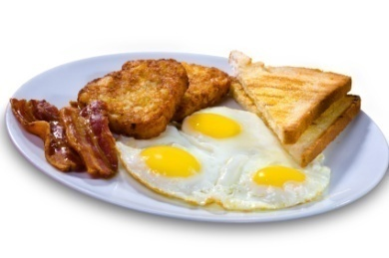
The weather was very hot and sunny last Saturday.
My family and I went to Sai Kung. We hurried to the cafe to have our breakfast.
Then, we hopped into Dad’s car and zoomed off.

Slide 3

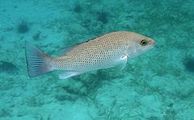
We arrived at Sai Kung as quick as a flash, we went to the beach. The water there was icy, it was perfect for the hot weather, so my dad went surfing with me.
He taught me how to do surfing tricks. Then I saw some tiny dull fish swimming around my feet. I thought that they were adorable
but my mum thought that they
were ugly.

Slide 4
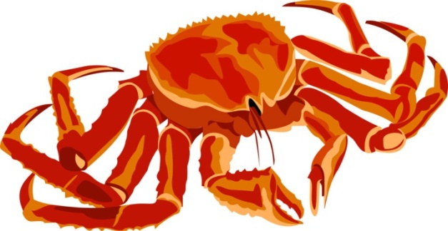
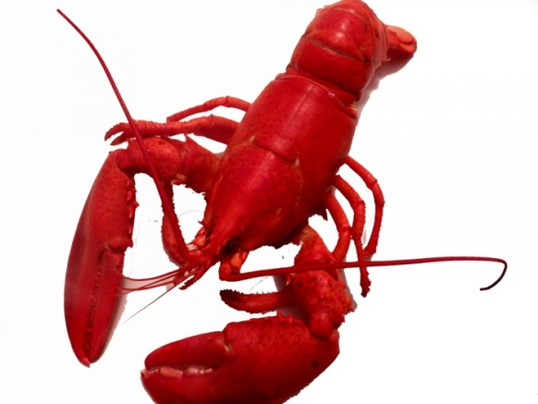
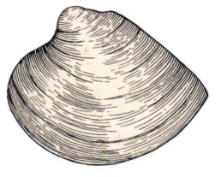
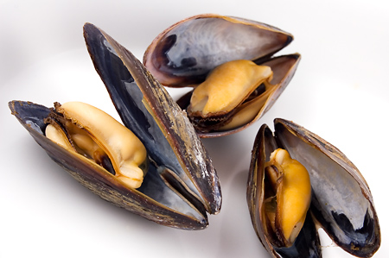
After that, we left the beach and went to a restaurant. We ate all different kinds of seafood, there were crab claws, lobsters, clams and mussels. They were delicious.

Slide 5

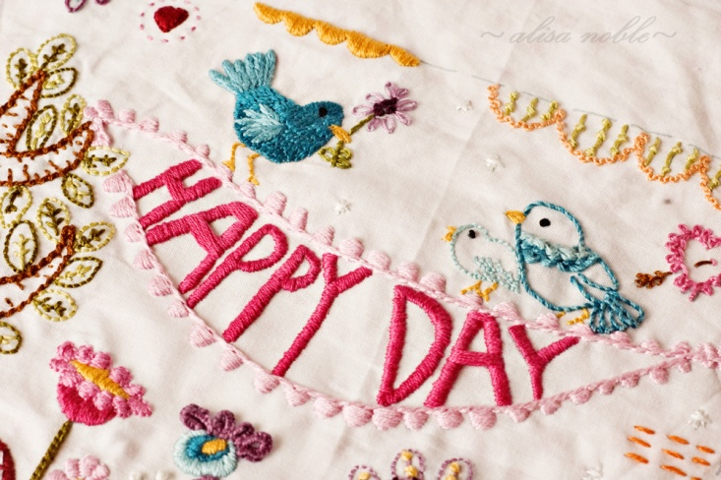
It was an extremely long day, I wished I could have this day again.

