Slide 1
Chan Yuen Ching (Renee)
A special day

Slide 2
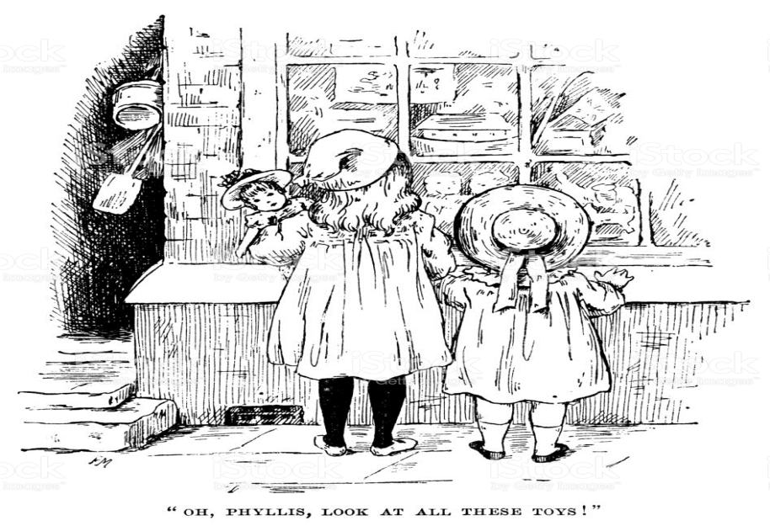
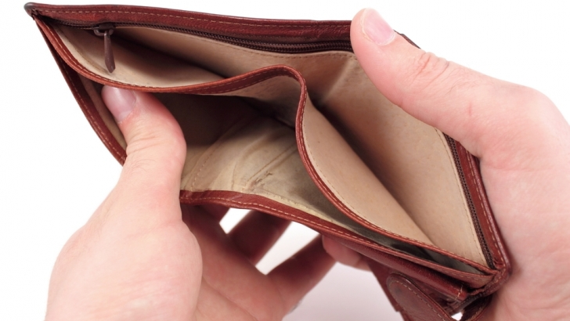
A special day
Lily walks in the street
and looks in the toy shop
window. She sees a doll. It is fifty dollars. The
doll is cute. It has long hair. It wears a pretty
dress. Lily wants to buy it very much but she
doesn't have any money. She feels upset.

Slide 3


A special day
On the street, Lily sees
fifty dollars. She wants to
buy the doll with fifty dollars so she picks up the money. She feels glad.

Slide 4

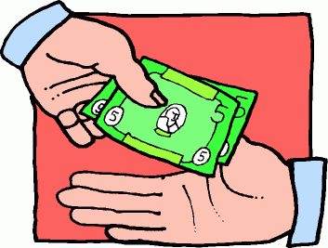

A special day
Then , she sees a boy and his mum.
They are looking for the money. They
feel worried. Lily feels guilty.
At last, Lily gives the money back to the boy. The boy feels joyful.

