Slide 1
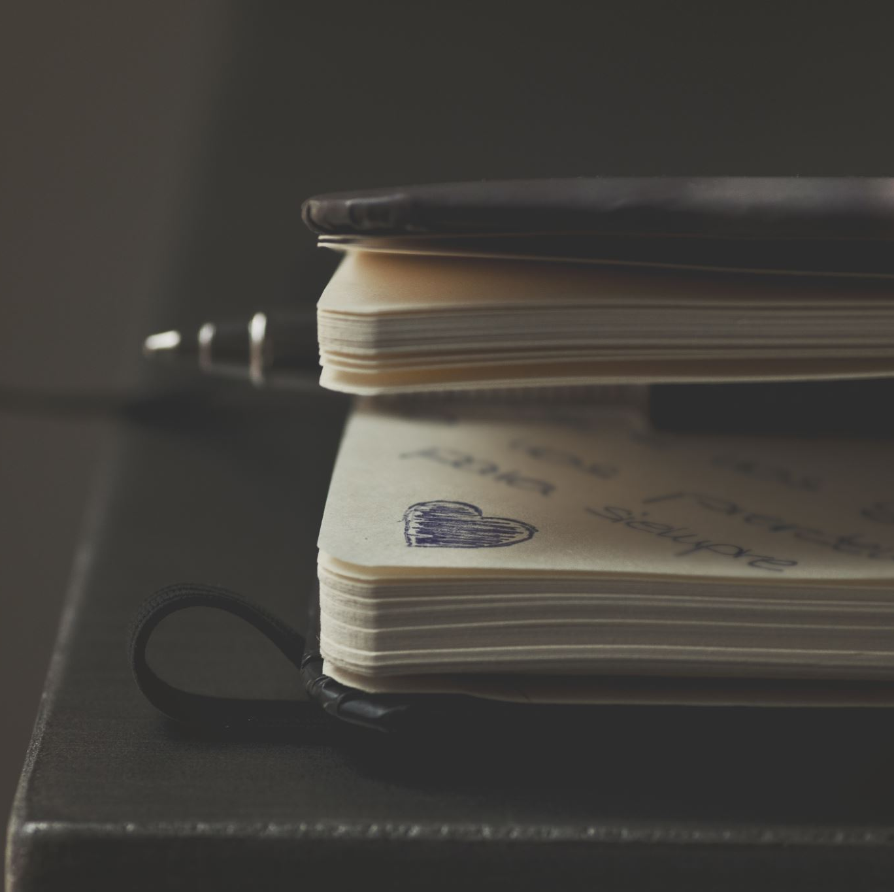
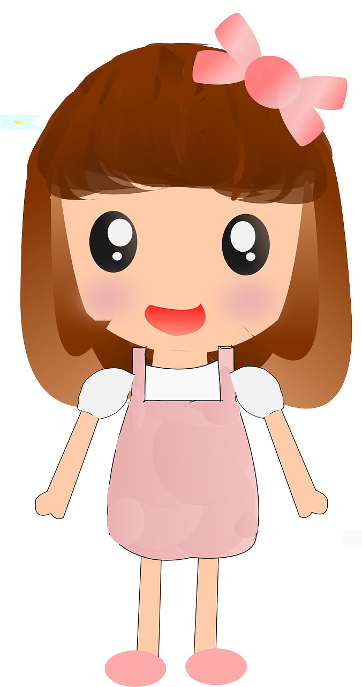
My diary
Written by Sally ( a doll )

Slide 2
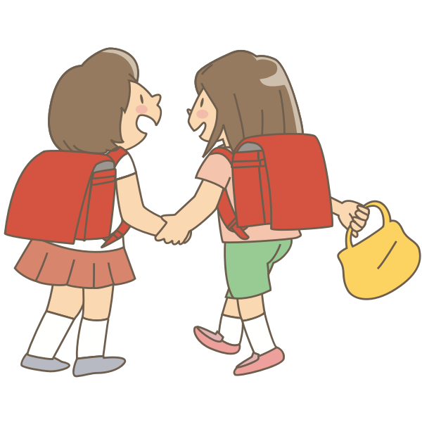
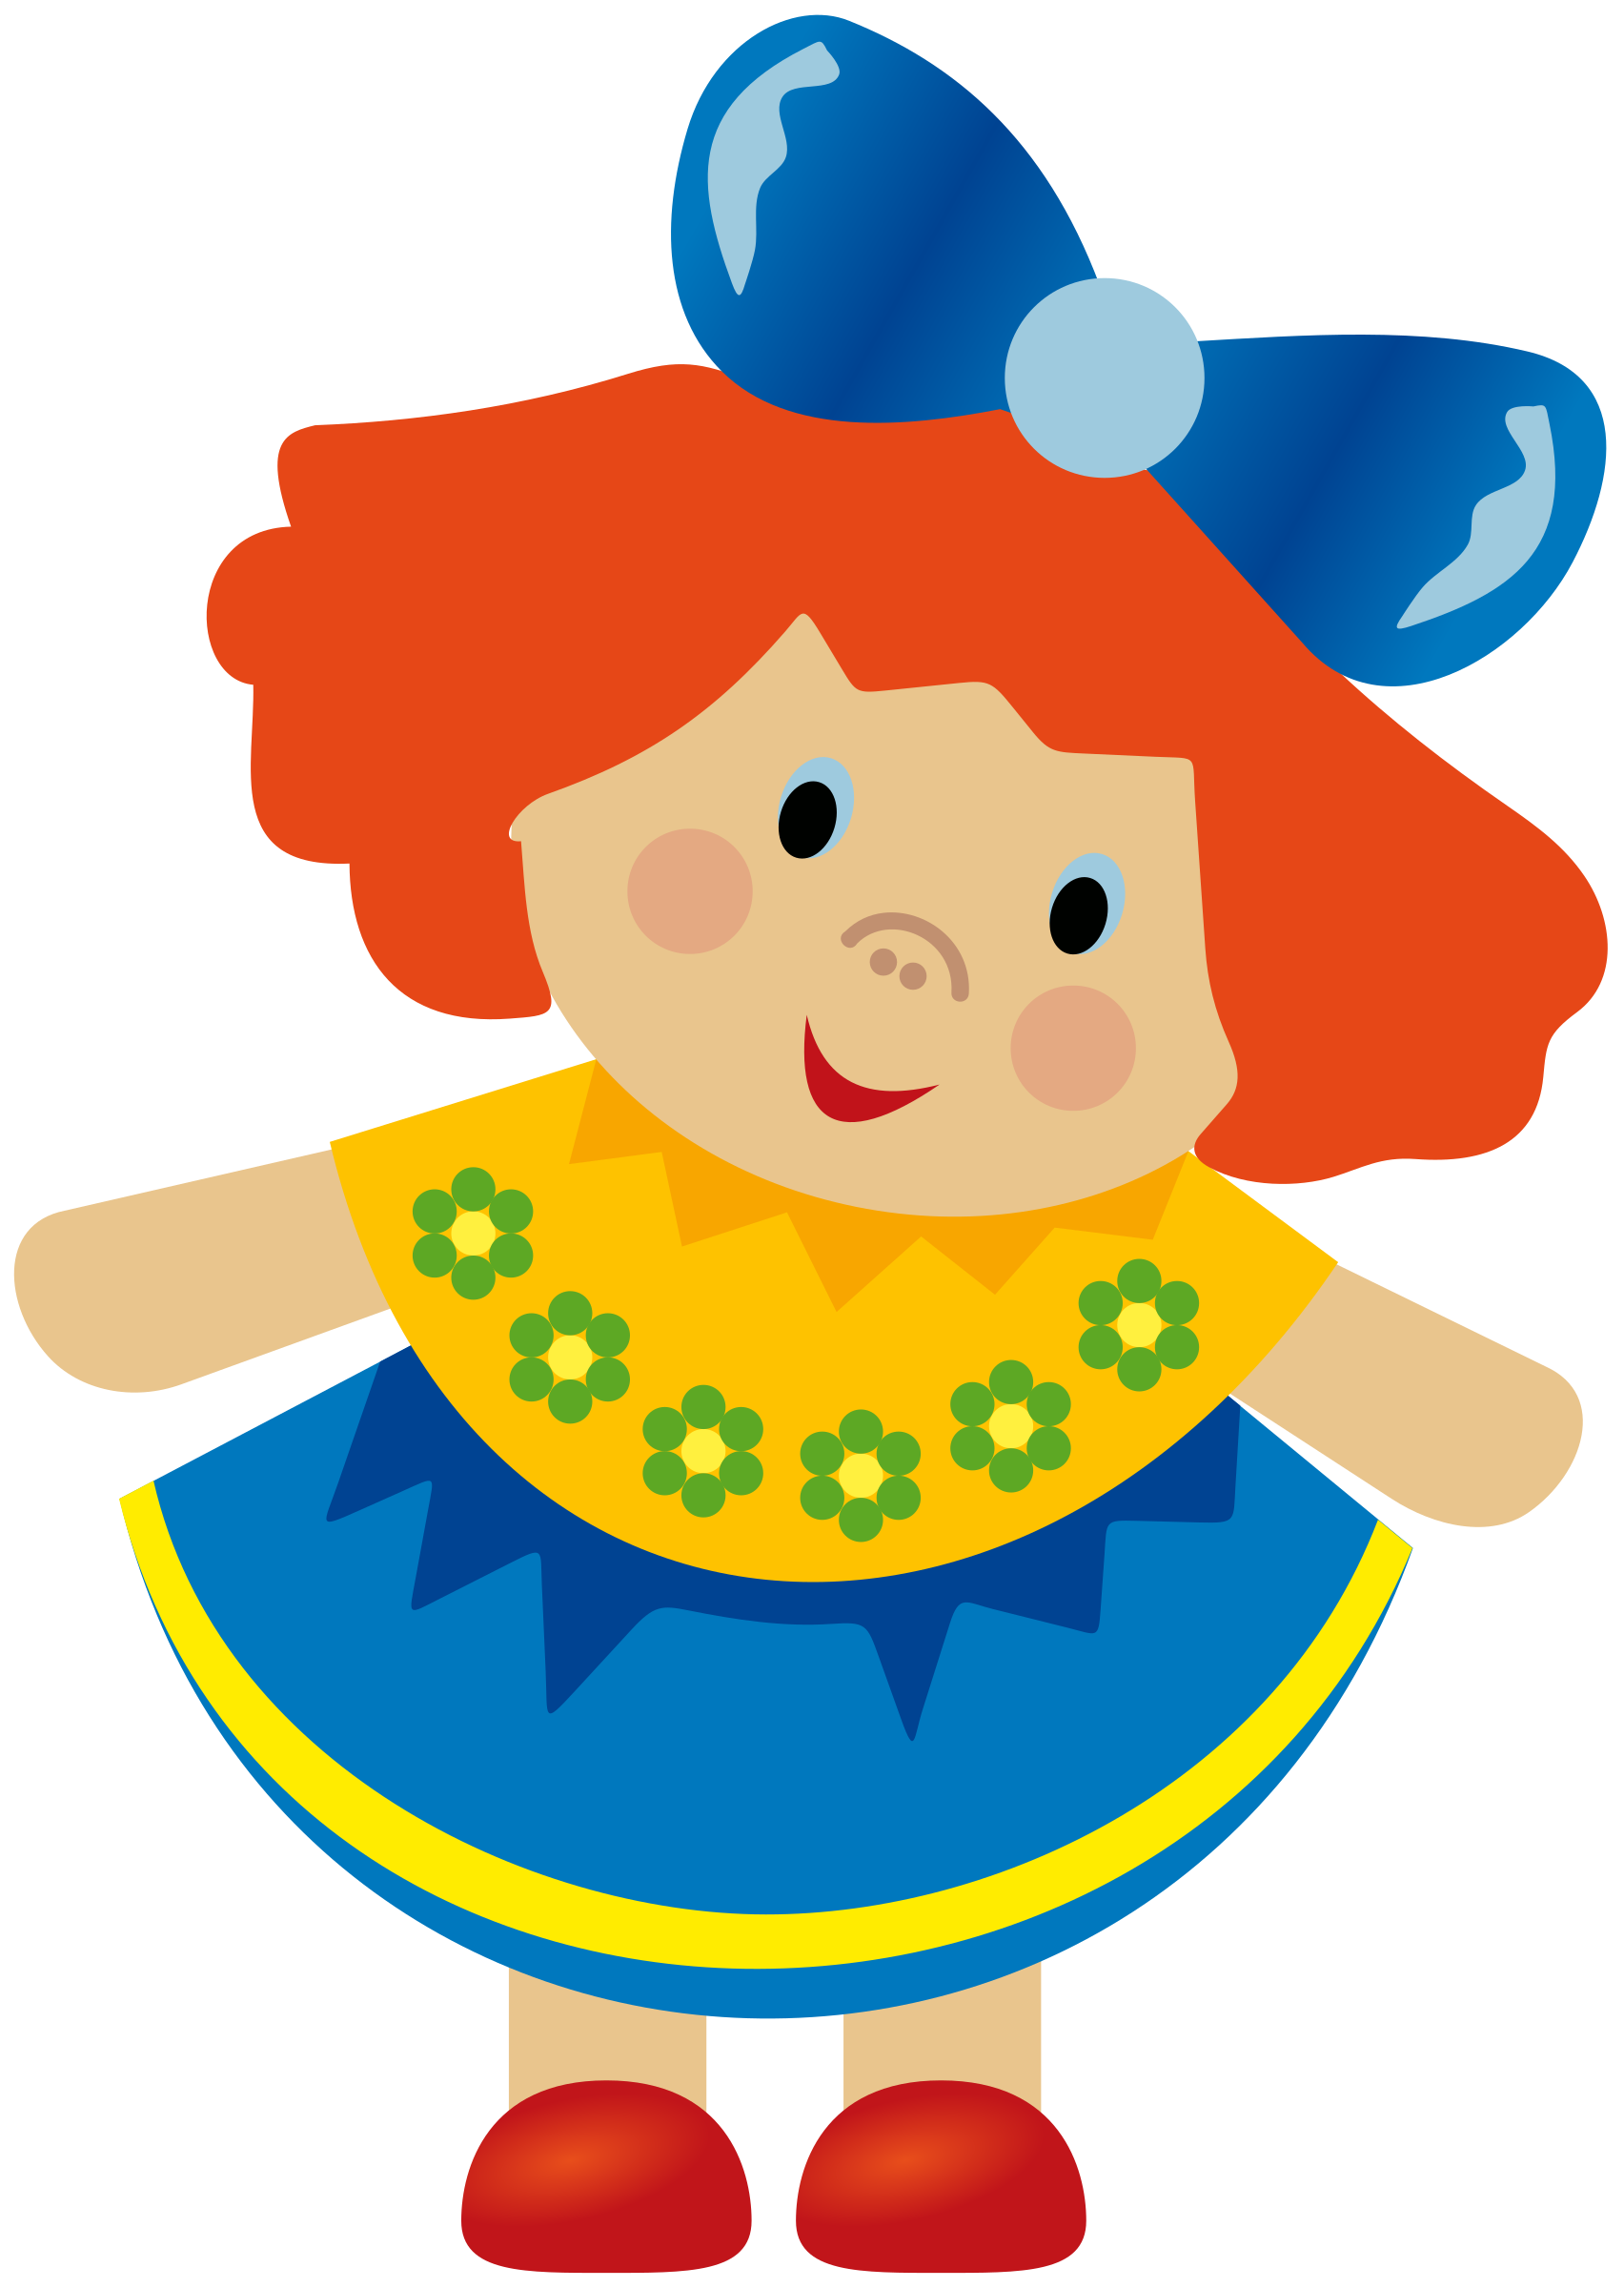
At Home……
Saturday 17th March Cloudy
What a joyful day ! May wasn’t here so I stayed in bed until nine o’ clock in the morning. At ten o’clock, I played with my best friend – Kelly.
Master (May)
….
….

Slide 3
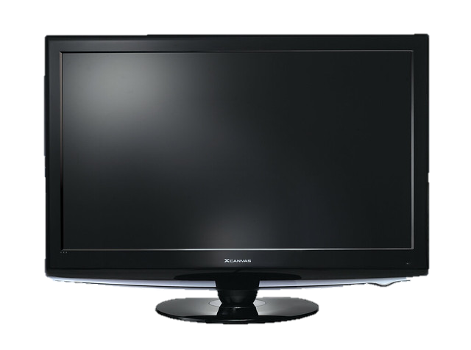
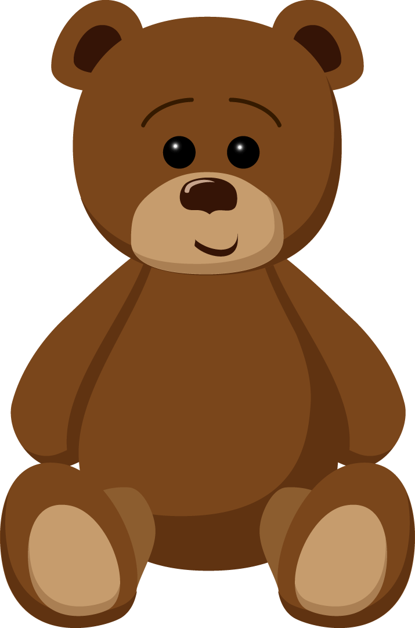
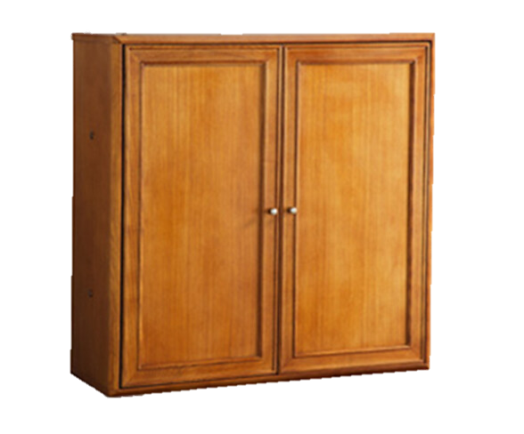
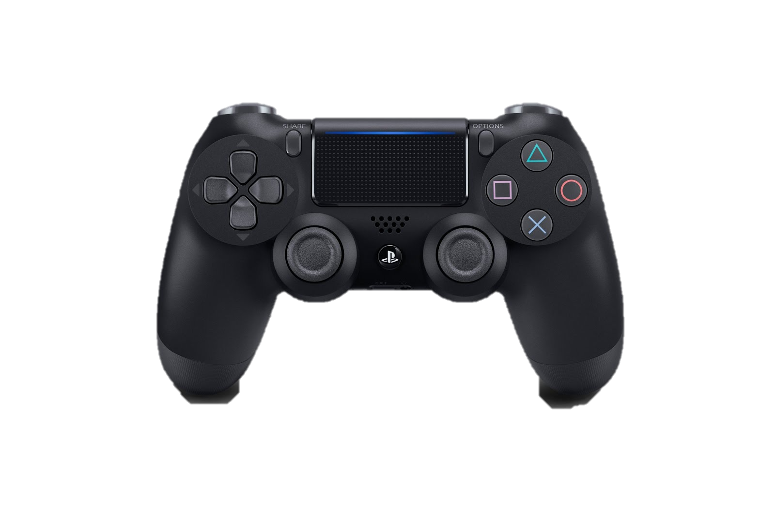
In the afternoon I played video games with my new friend – Bear Bear. It was fun! We were excited.
此相片 (作者: 未知的作者) 已透過 CC BY 授權

Slide 4
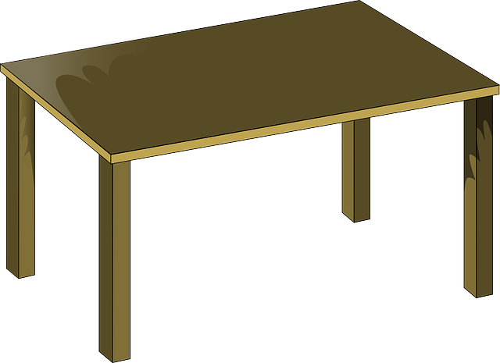
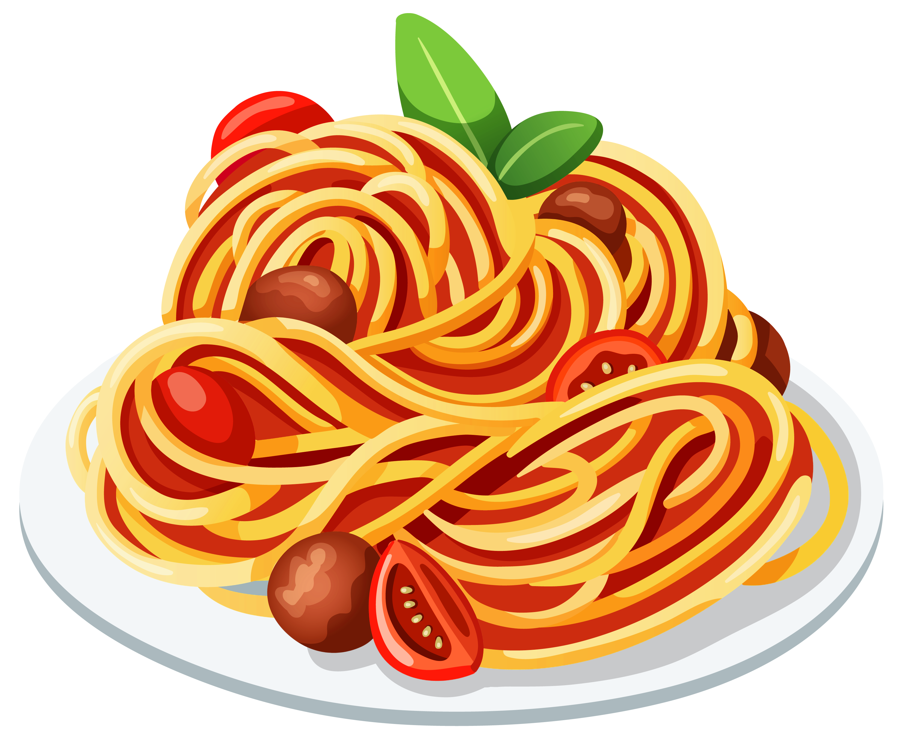
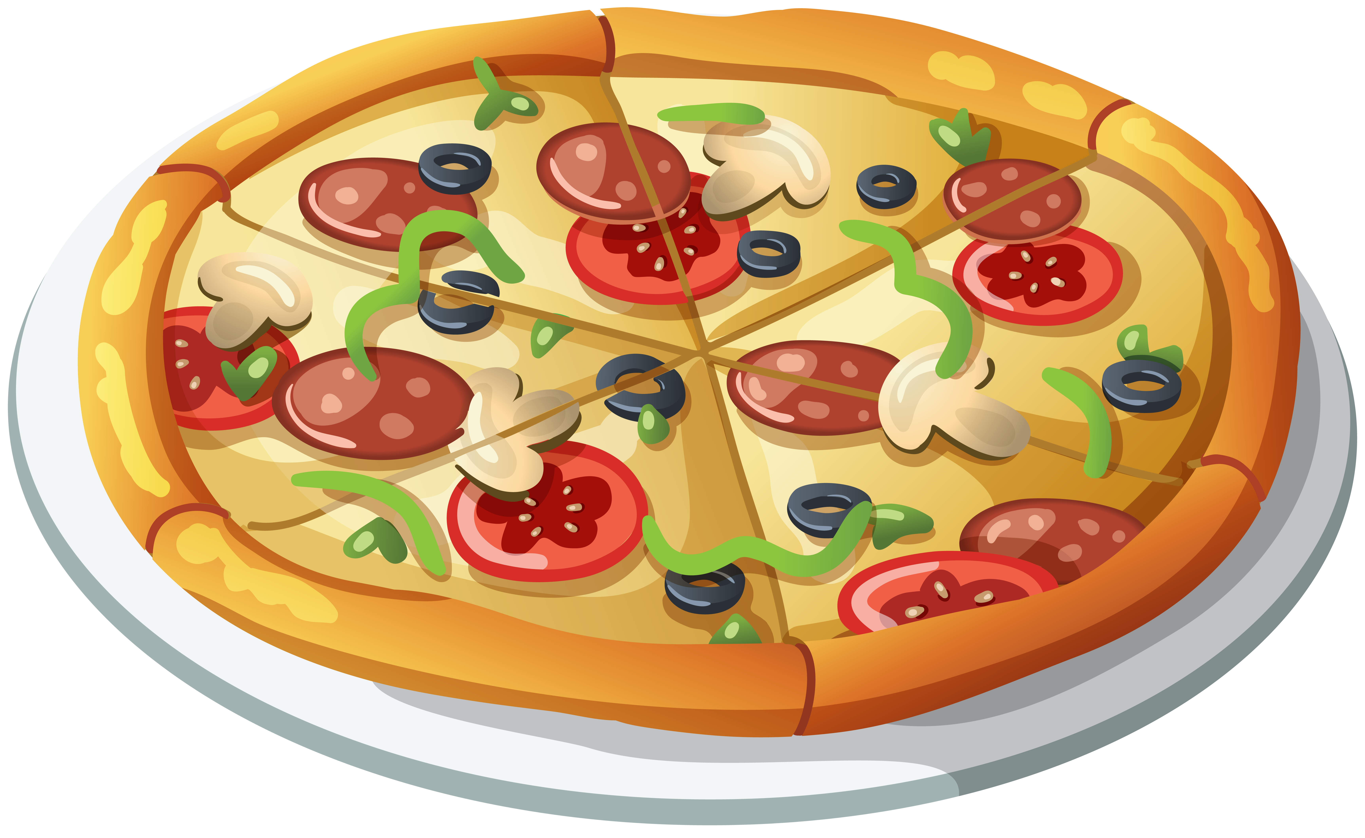
In the evening, we were hungry so we ordered Pizza Hut. We ordered two bowls of mushroom rice, a seafood pizza and a plate of tomato spaghetti. We watched dance show on TV when we were having dinner.
此相片 (作者: 未知的作者) 已透過 CC BY-NC 授權
此相片 (作者: 未知的作者) 已透過 CC BY-NC 授權
此相片 (作者: 未知的作者) 已透過 CC BY-NC 授權
此相片 (作者: 未知的作者) 已透過 CC BY-NC 授權

Slide 5
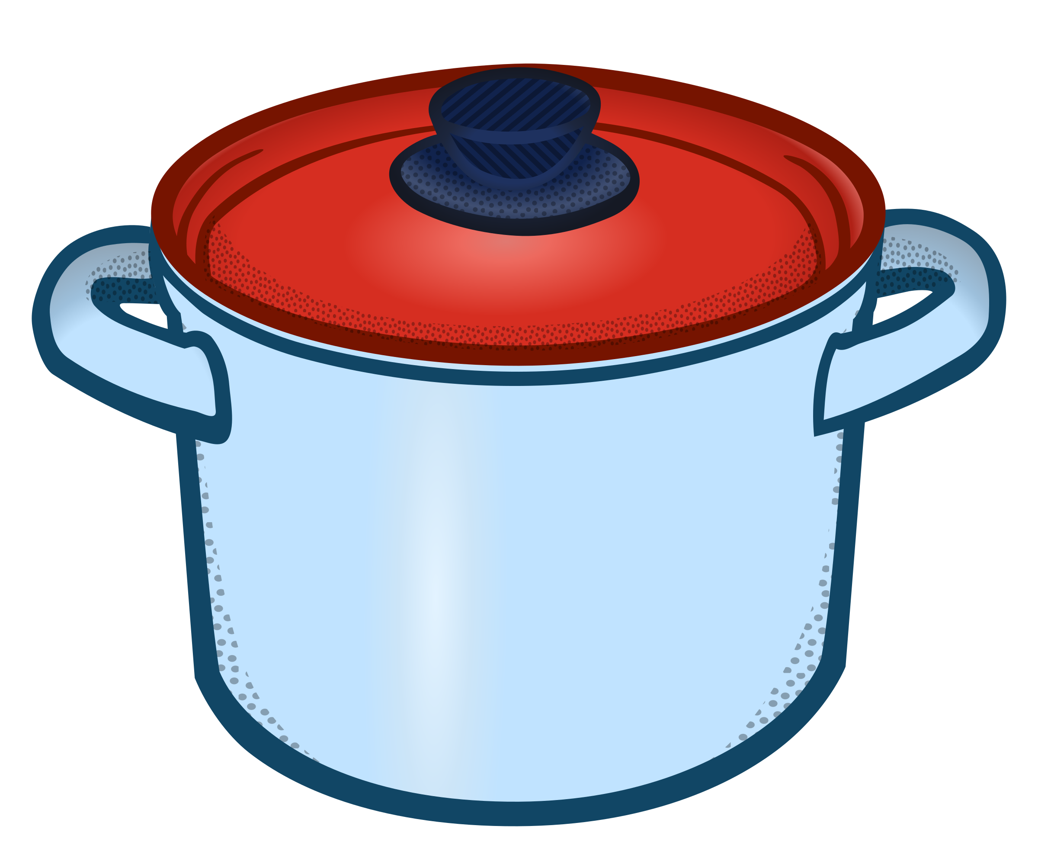
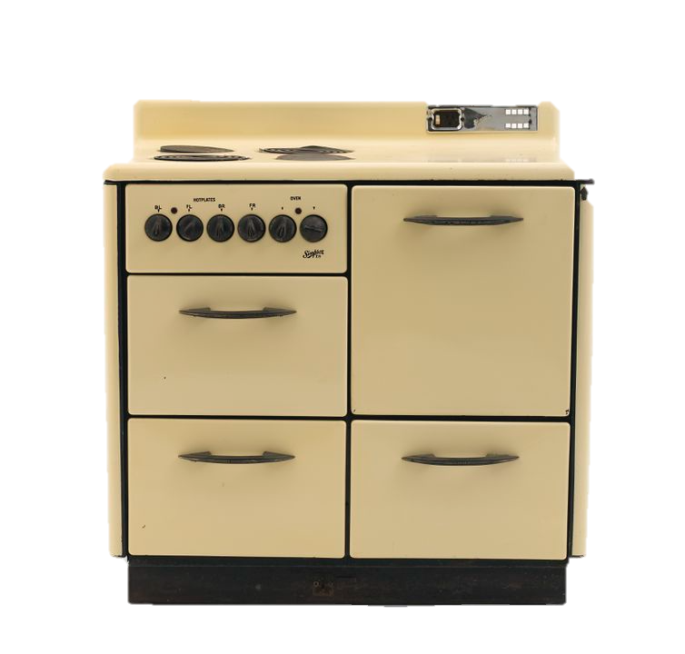
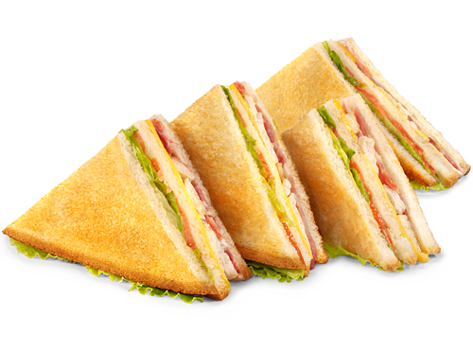
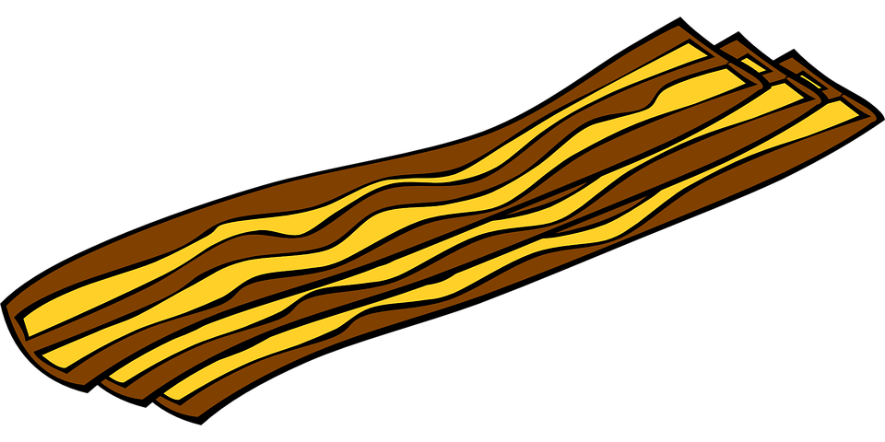
Sunday 18th March Sunny
I got up early in the morning. My two friends were sleepy so I let them sleep until ten o’clock. I cooked breakfast. We ate ham and cheese sandwiches for breakfast. They were delicious! Then, we watched our favourite cartoons after breakfast.

Slide 6
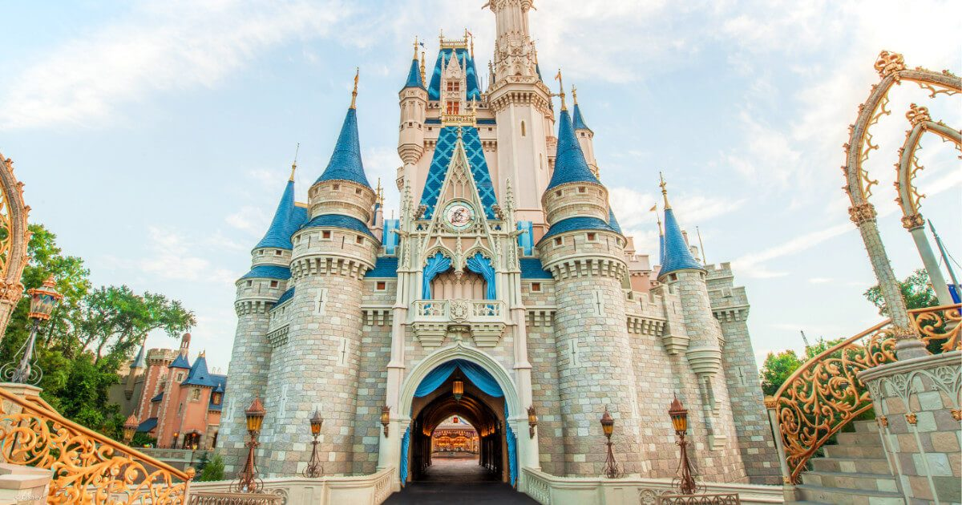
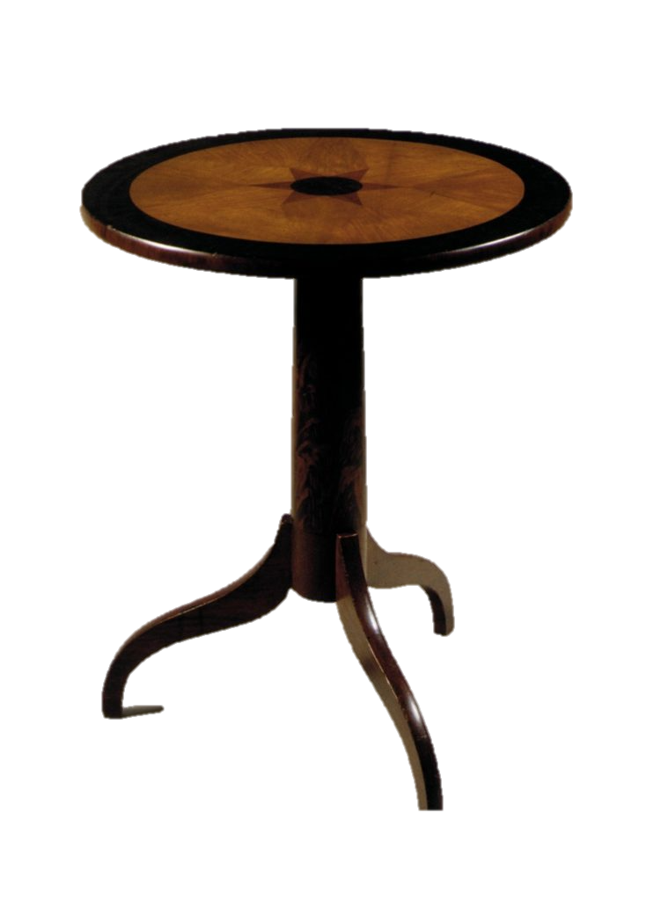
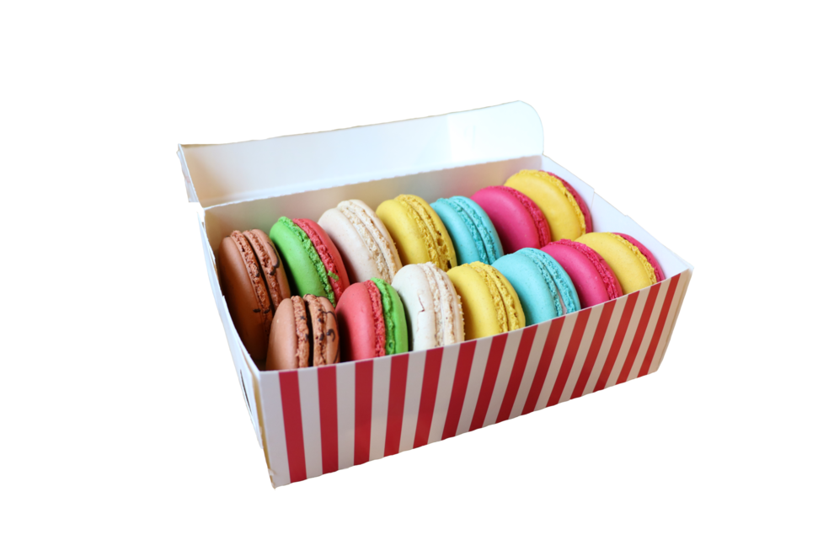
In the afternoon, we went to Disneyland. We arrived at the castle at three o’clock. Then, we had afternoon tea. We went on many rides like Dumbo, Grizzly Roller Coaster and Small World. We left at six o’clock in the evening.

Slide 7
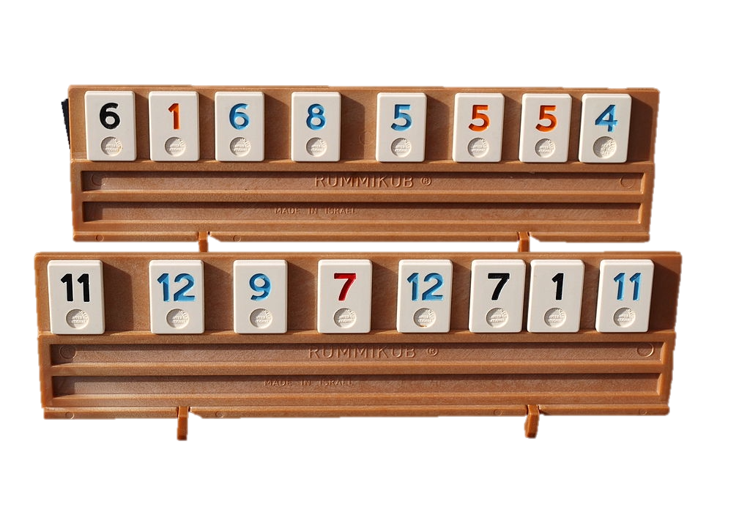
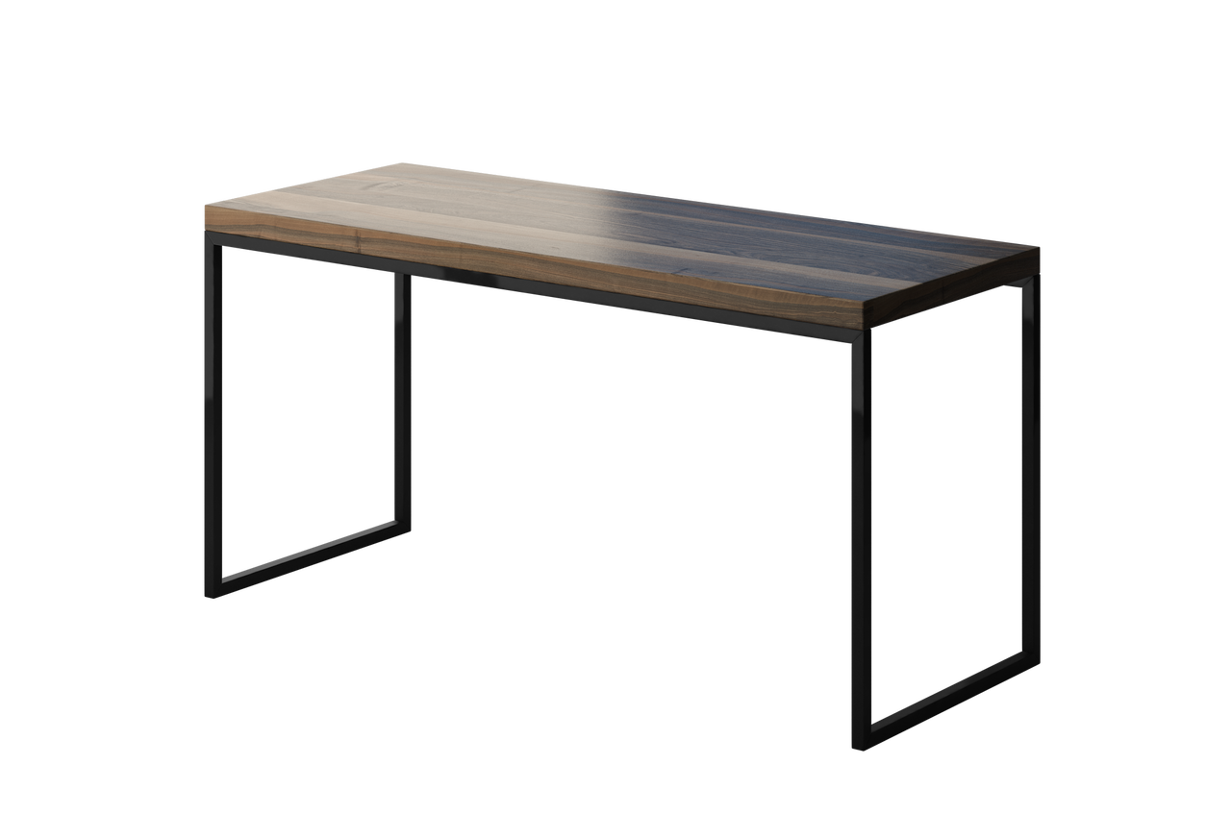
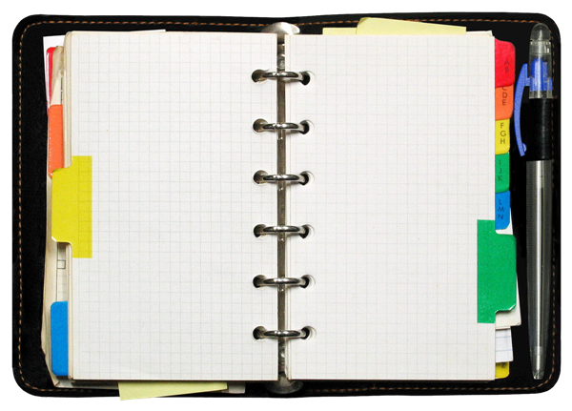
In the evening, I drew a beautiful picture. We tidied May’s bedroom because it was messy. After that, I was tired so I didn’t play Rummikub with Bear Bear and Kelly.

Slide 8
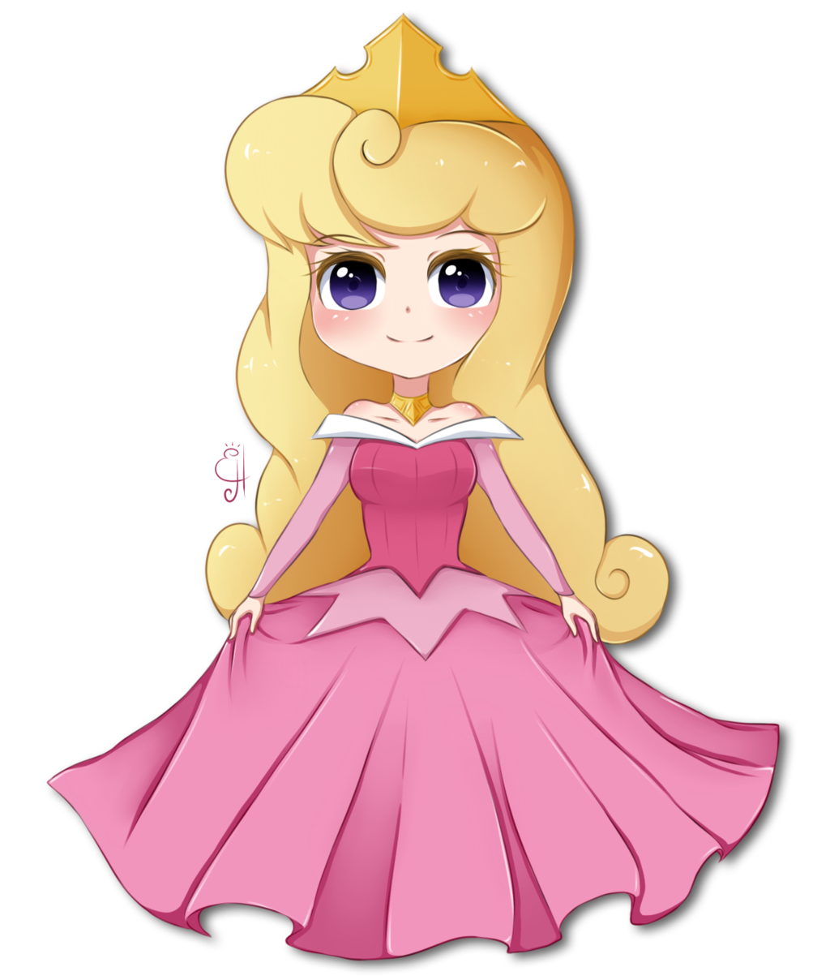
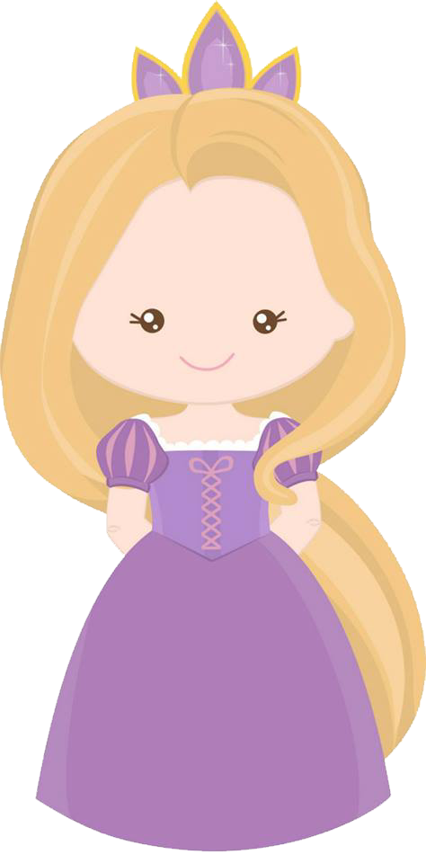
Oh! Sally! Are you ok? Sorry I went to Disneyland without you. Were you bored?
Mom
May (Master)
That’s alright. My weekend was fantastic.

